Slide 1
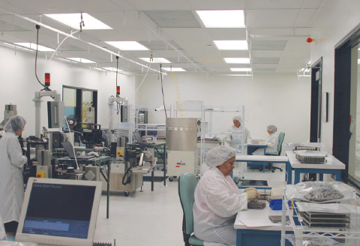
©Copyright July 2014 DESCO INDUSTRIES INC.
DescoEMIT.com

Slide 2
Why Room Ionization?
ESA vs. ESD
Electrostatic discharge or ESD causes damage
The presence of excess charge on a surface can create an electrostatic field that causes the formation of a spark (ESD), which can damage microelectronic components and give rise to electromagnetic signals that disrupt, for example, robotic equipment.
Electrostatic attraction or ESA that can lead to damage
The presence of excess charge on a surface also creates an electrostatic field that will accelerate deposition of oppositely charged particles and thus accelerate contamination.
DescoEMIT.com

Slide 3
Why Room Ionization?
ESA
The dominant type of ESA is almost always the attraction or repulsion of a charged particle by a charged surface. The number of particles deposited on a surface is proportional to:
- Particle charge and concentration
- The electrostatic charge per area on the surface
- The duration of exposure
DescoEMIT.com

Slide 4
Why Room Ionization?
ESA
Charged surfaces accelerate the deposition of particles of opposite polarity, accelerating contamination.
Deposition rates per surface area are proportional to the electric field (surface charge density) and to the particle charge, concentration and electrical mobility.
Current standard contamination control procedures can minimize concentration.
Room Ionization is able to reduce particle charge and surface charge, reducing this source of particulate contamination.
DescoEMIT.com

Slide 5
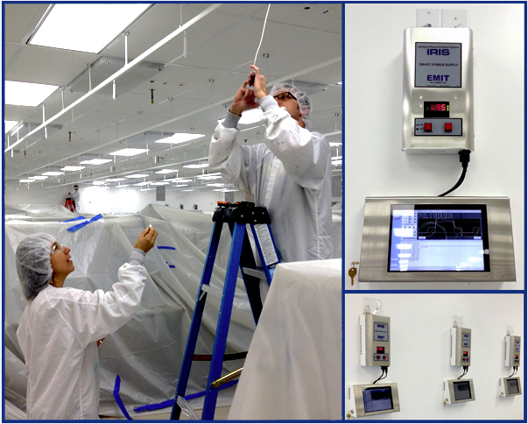
IRIS Design
IRIS Room Ionization System is a single-wire, bipolar, corona ionization system generating both polarities of ions at each single emitter unit conforming to ANSI/ESD S20.20 tested per ANSI/ESD STM3.1 and ESD TR53. IRIS operates on pulse DC.
DescoEMIT.com

Slide 6
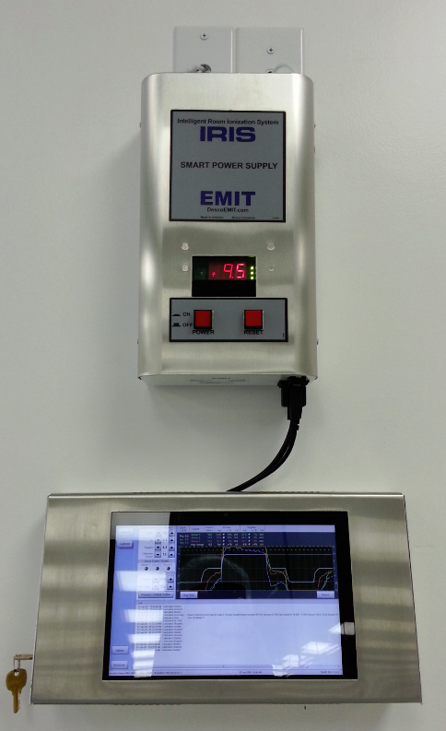
IRIS Power Supply & Tablet
IRIS Power Supply Configuration
IRIS Power Supply controls each Zone
IRIS Power Supply is controlled by Tablet PC
Tablet PC controls IRIS Power Supply via TEAM5 IRIS Client Software
3 Sensors per Zone provide feedback to monitor stability of the Zone
TEAM5 IRIS Server monitors all Zones running TEAM5 IRIS Client
Requirements to support configuration include
2 AC Outlet
Ethernet connection to support TEAM5 IRIS Server
DescoEMIT.com

Slide 7
IRIS
Systems Features
Bi-polar ionization from a single emitter tip - yields unsurpassed ion production and equal ion production. Each polarity is affected the same by wear or build up on the tip resulting in stable ion production over time.
Lightweight, modular emitter system – no heavy power supplies mounted overhead, easy to maintain emitters, easy to change room layout.
Precision real time ion sensing and cycle timing - offers superior balance.
White ABS construction – superior cleanroom performance.
Powered by a digital, high-accuracy, laboratory-grade power supply – only one power supply needed per room, substantially decreasing calibration time, up to 250 emitters.
Touch screen computer management software – event and fault monitoring with alarms and logging.
Uninterrupted 24x7 operation – no operator interaction required Absolute Protection for your Critical Processes.
DescoEMIT.com

Slide 8
TEAM5 IRIS Software
Systems Features
No single point of failure – Each Zone has it own client software monitoring system.
IRIS Client Software – Touch screen compatible allowing for ease of calibration and adjustment.
IRIS Server Software –synchronization and remote monitoring of multiple Zones.
Simultaneous Calibration / Operation - Other Zones may continue to operate while one or more zones are being serviced.
Monitoring – TEAM5 IRIS Client software shows detailed feedback for Three sensors and HV displayed on each tablet PC where the IRIS operates.
No Serial Cable Network Required - communication between the client software and server software is handled via Network (Wired or Wireless).
DescoEMIT.com

Slide 9
IRIS
Systems Benefits
Excellent performance in charge decay and particulate control – fully adjustable and biased ion output.
Industry leading with minimal total cost of ownership - Single power supply architecture substantially reduces up front investment and subsequent maintenance costs compared to other systems on the market.
Reduced oversight by QA and production control - built for unattended operation; lowest maintenance cost in the industry.
Flexible, modular design - installation can be modified, added to or moved without special tools.
Far lower build up and therefore less particulate generated at the emitter tip. The emitter tip is grounded between pulses which minimizes the attraction of ions back to the emitter tip when the next pulse is energized. This reduces build up and tip fatigue from ions striking the tip as happens with dual polarity emitter systems.
DescoEMIT.com

Slide 10
Competitive Analysis
 |  |  |  |  | DECAY RATE (seconds) |  | OFFSET (volts)
 |  |  |  |  | Mar-08 |  | Mar-08
 |  |  |  |  | Positive | Negative | Positive | Negative
Ion Systems Zone 2 average readings |  |  |  |  | 60 | 60 | 84 | -88
IRIS system average readings |  |  |  |  | 44 | 46 | 75 | -69
IRIS out performs the competition by 25% on average
IRIS guarantees 100% ion coverage for entire clean room
IRIS Data - Original install 2002
Ion Data – Original install 1997-2004
DescoEMIT.com

Slide 11
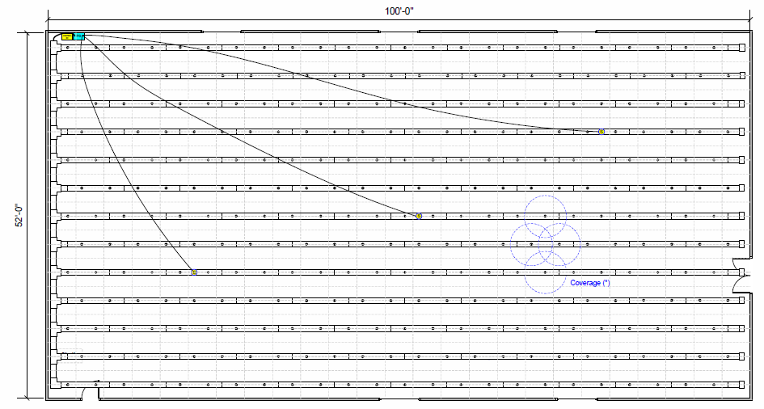
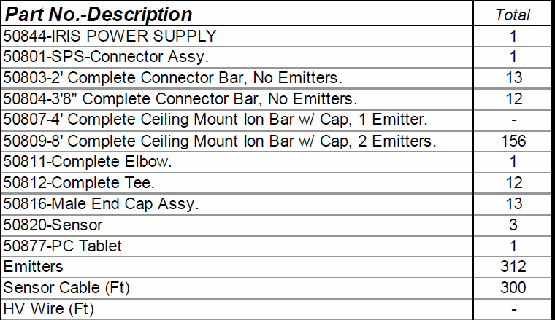
IRIS Layout
DescoEMIT.com

Slide 12
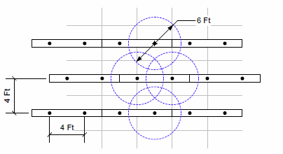
IRIS Layout
IRIS Emitter Coverage
DescoEMIT.com

Slide 13
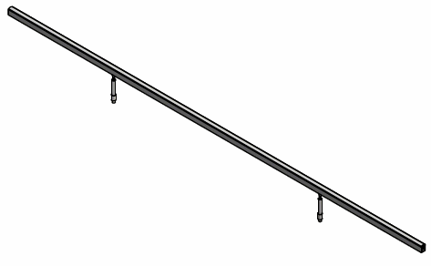
IRIS Component Parts
8ft. Complete Ceiling Mount Ion Bar with Flat Cap, 2 Emitters
DescoEMIT.com

Slide 14
IRIS Component Parts
Emitter,Tungsten, 6 in. long 2 in. flex extender
DescoEMIT.com

Slide 15
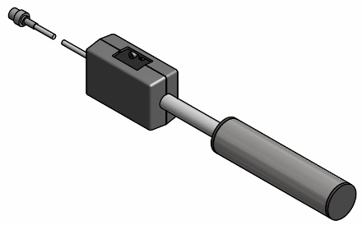
IRIS Component Parts
Three sensors per Zone provide feedback to Client Computer via the same serial communication line used to control IRIS Power Supply.
DescoEMIT.com

Slide 16
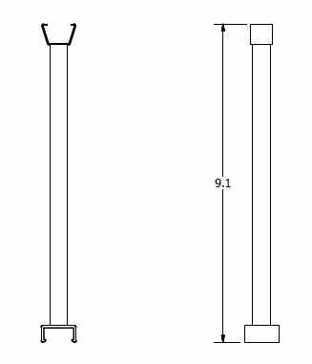
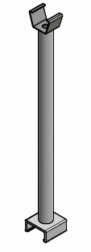
IRIS Component Parts
Hanger – 9 in. long, with clip used to support
IRIS Linear Bar Design
DescoEMIT.com

Slide 17
IRIS Installation
DescoEMIT.com

Slide 18
IRIS Specifications
Emitter Capacity: Approximately 300 per power supply or 5,000 sq ft.
Emitter Control: fully programmable, 0-99.9 second ionization ON cycle for each polarity with selectable quiescent periods between cycles
Power Supply Indicators: power ON, alarm, positive and negative voltage output and neutral delay
Zone Sensors: Independent, cylindrical detectors with BNC connectors, RG58 or equivalent cabling (provided)
DescoEMIT.com

Slide 19
IRIS Specifications
Power Supply Dimensions: 20.75cm W x 49.5cm H x 15.24cm D
Power Supply Weight: 30 lbs. (11.2 kg)
Offset Voltage (Balance): <±150V per ANSI/ESD S20.20
Calibration: Semi-annual calibration recommended
DescoEMIT.com

Slide 20
IRIS Specifications
The performance of the EMIT IRIS –Intelligent Room Ionization System is directly related to uniform airflow throughout the area being ionized. Minimum laminar airflow of 70 FPM (0.4 m/sec) and distance from emitter to test surface of 5 ft. is necessary to enable the system to meet Offset Voltage (Balance) and Voltage Decay (Discharge Times) performance specifications. In the event that minimum environment specifications cannot be met, some system modification may be required. In addition, some large objects (machines, etc.) may have a significant effect on the ionization performance in the vicinity of the objects.
DescoEMIT.com

Slide 21
IRIS Specifications
Upon completion of IRIS Installation, IRIS will be calibrated to the required limits of ANSI/ESD S20.20 with offset voltage of less than +/-150V, as well as predetermined decay times agreed upon by both customer and EMIT tested per ESD TR53. Any changes to the environment of the IRIS installation Scope of Work after the installation may require modifications and recalibration. This includes and is not limited to airflow changes to the environment, layout changes (including work benches and machinery). All ionizers require periodic maintenance, emitter pin cleaning, and recalibration. Associated costs are not included in the original purchase price. All testing and recalibration of the IRIS performed after installation will be quoted to the customer for parts and labor separately from the initial Quotation and Purchase Order.
DescoEMIT.com

Slide 22
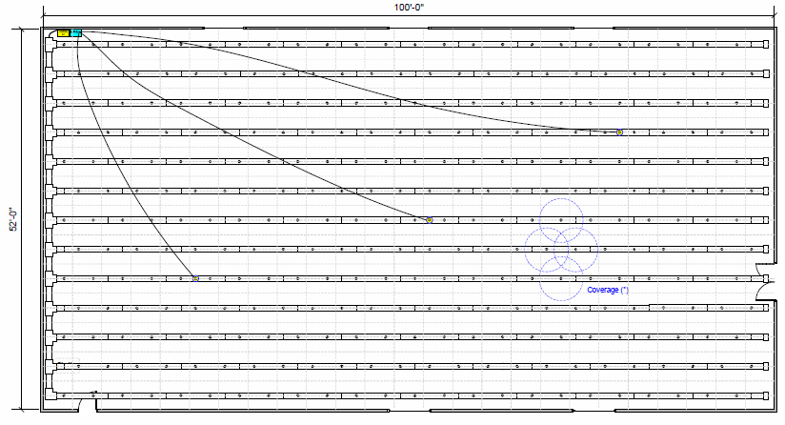
IRIS Specifications
HV Serial connections with internal wiring
Sensor cables run independently to sensor locations
Ceiling clip connectors – no tools or adhesive used
Easy reconfiguration for remodel or layout changes
Layout flexibility for optimal ion positioning with FFU
DescoEMIT.com

Slide 23
IRIS Test Method
The area around the charged plate monitor should be cleared for a horizontal distance of 5 ft. in all directions. The ionization system should be operated for a minimum of 30 minutes to stabilize conditions in the test area.
During the test, the test technician should be grounded and stand outside the 5 ft. cleared area.
Discharge Time from a 1,000 volt initial voltage to a 100 volt final voltage shall be measured for both positive (+) and negative (-) polarities.
The air velocity at the test location should be recorded
DescoEMIT.com

Slide 24
IRIS Test Method
Measurements should be taken with the charged plate monitor at a distance of 5 ft. from the ionizer under test. Since installed ionizer heights may vary, a consistent measurement height should be selected for the evaluation of different systems. This height and the ionizer mounting height shall be recorded in the test results.
The minimum number of test locations is 3 Per ANSI/ESD STM3.1.
Discharge Time from a 1,000 volt initial voltage to a 100 volt final voltage shall be measured for both positive (+) and negative (-) polarities should be measured at each test point.
Offset voltage as described in 6(b) and 6(e) should be determined at each test location.
Offset voltage shall be measured after a period of at least 1 minute to allow the reading to stabilize (5 minutes maximum).
DescoEMIT.com

Slide 25
IRIS Client
Overview
IRIS Client / Power Supply Communication IRIS power supplies are controlled via a serial communication line hard wired to an IRIS client computer. The client computer switches the power supply between three states (Positive / Negative / No Power). The duration of each power state is adjusted manually via the IRIS Client while monitoring the work environment with a Charge Plate Monitor until the desired conditions are achieved. This process is called ‘Calibration’. The duration of each power state is recorded and saved during calibration. These values are then used by the client computer to control the power supply during production. Each power supply has three sensors which provide feedback to Client Computer via the same serial communication line used to control power states.
DescoEMIT.com

Slide 26
IRIS Client
Overview
IRIS Client / IRIS Server Communication
The IRIS System uses a single ‘Server’ computer to monitor the status of all IRIS Client Computers and their power supplies or 'Zones'. All Client / Server communication takes place over a local area network (LAN). There are three types of communication between the IRIS Server and Clients.
IRIS Server receives status updates from each zone once every second.
IRIS Server synchronizes Positive / Negative / No Power states across all zones by sending synchronization commands to each Client.
In case all power supplies need to be stopped, for periodic maintenance or an emergency shutdown, a command is sent to all Clients to stop their power supplies.
In all three cases, data is sent and received in very small data packets (just a few bytes). None of these require high speed network response times. There are no third party interfaces to allow other systems to control the IRIS Clients.
DescoEMIT.com

Slide 27
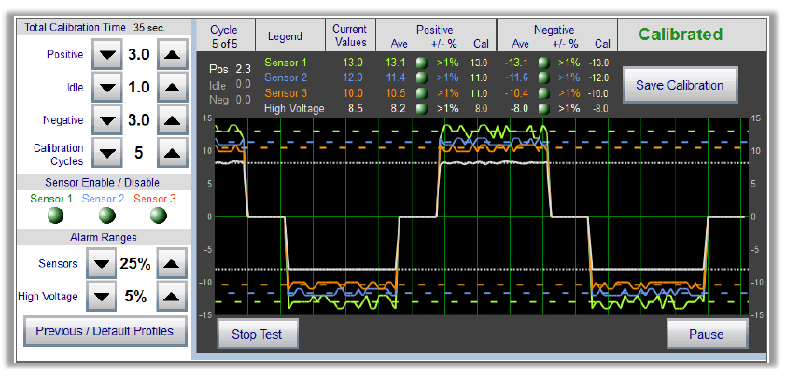
IRIS Client
Overview
DescoEMIT.com

Slide 28
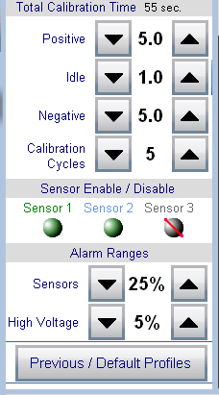
IRIS Client
Calibration Controls
Total Calibration Time
Timing settings manually controlled and saved
Calibration Cycles adjustable to compensate for dynamic environments
Calibration time automatically calculated
Sensor Enable/Disable Disabling sensor due to unordinary maintenance or activity in clean room
Disabling sensor to display only one trend on display screen
Alarm Ranges
Alarm ranges will determine the sensitivity of the monitoring of each sensor
Determines when a warning message will display if average value of the sensor is exceeded
Previous/Default Profiles
“Current Values” are equal to the values saved
“Factory Defaults” are values set at time of TEAM5 IRIS install
“Previously Saved” are values that can be selected from calibration history
DescoEMIT.com

Slide 29
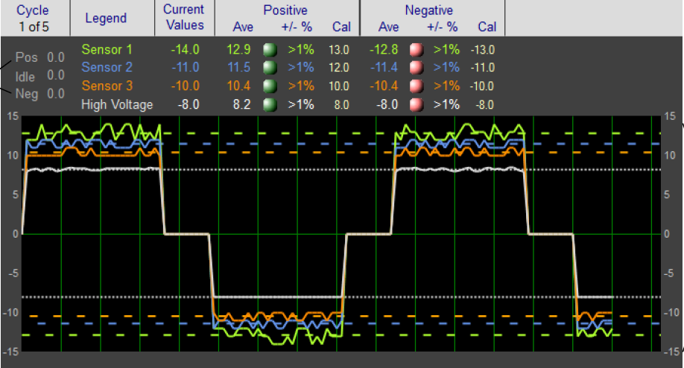
IRIS Client
Calibration Monitor
DescoEMIT.com

Slide 30
IRIS Client
Calibration Monitor
Cycle - Shows the current calibration progress and number of determined cycles selected. Example is 5 above
Legend - Shows the colors used to indicate the 3 Sensors and High Voltage
Current Values - shows the data points collected in real time from the sensor feedback and high voltage
DescoEMIT.com

Slide 31
IRIS Client
Calibration Monitor
The Average Value (Ave) is the average sensor reading during the current power cycle. The Calibration Value (Cal) is the average values of sensor data collected over the course of the selected cycle count. Example above is 5 cycles. The Calibration Value is stored once the calibration cycle is completed.
DescoEMIT.com

Slide 32
IRIS Client
Overview
During monitoring, the Average Value (Ave) collected from the sensor feedback is compared to the Calibration value. A sensor alarm is triggered if the sensor or power values deviate from the saved Calibration Value (Cal) by more than the selected alarm range percentage.
Positive and Negative shows the Average Value (Ave) percentage of the variation from the Calibration Value (Cal) for each sensor and High Voltage.
DescoEMIT.com

Slide 33
IRIS Client
Calibration Monitor
DescoEMIT.com

Slide 34
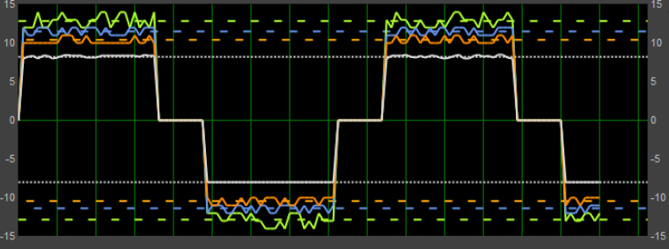
IRIS Client
Calibration Monitor
Solid lines displayed in graphical and digital form the feedback from three sensors and the High Voltage output.
Dashed lines show average values for Sensors and High Voltage values.
Positive, Idle, and Negative Cycle displayed and monitored.
DescoEMIT.com

Slide 35
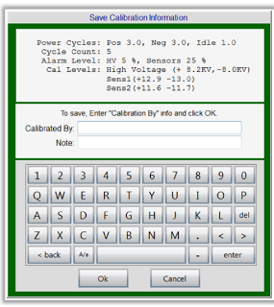
IRIS Client
Calibration Monitor
Once the average of each sensor and high voltage output are within the selected alarm ranges, a button named "Save Calibration" will be displayed.
A summary of calibration values is displayed.
Enter Name of Initials of person who performed calibration.
Optionally, a brief text notation may be entered
DescoEMIT.com

Slide 36
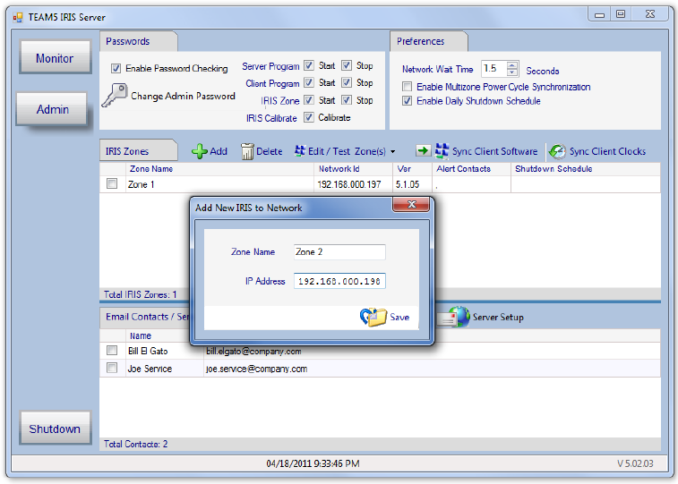
IRIS Client
Admin Options
DescoEMIT.com

Slide 37
IRIS Server
Calibration Monitor
Multizone Power Cycle Synchronization allows synchronization of multiple zones when more than one IRIS Power supply is installed in the same room.
Daily Shutdown Schedule allows the Server to shutdown each IRIS Zone on a scheduled basis.
The IRIS Server can maintain a list of Alert Contact Email Addresses, allowing IRIS to send email alerts to specific individuals in the event of an Alarm on an IRIS Zone.
Monitoring Zones allows all zones to be monitored, settings to be updated and power cycles to be synchronized. The status of each zone is requested by the server and then displayed on the monitoring page.
DescoEMIT.com

Slide 38
Contact Us
Need More Information?
For a demonstration contact EMIT at DescoEMIT.com or 909-664-9980.
DescoEMIT.com

