Slide 1
EMIT
SmartLog Pro® 2
ESD Results at your Fingertips
© 2022 DESCO INDUSTRIES INC

Slide 2
The SmartLog Pro® 2 verifies the functionality of an operator’s wrist strap and footwear, logs the test record, and controls access to an ESD Protected Area.
All operator test activity is logged into a database to meet the ANSI/ESD S20.20 requirement for “Compliance verification records shall be established and maintained” and for on-going quality control purposes.
Each log entry includes operator identification, test results, resistance measurements, time, temperature and humidity.
Operator identification and access control is performed using the embedded RFIdeas proximity reader or touchscreen keypad.
Access control to an ESD Protected Area can be further enforced by using the relay terminal on the SmartLog Pro® 2. It can be connected to an electronic door lock or turnstile to grant access only to those who have passed their pre-defined ESD tests.

Slide 3
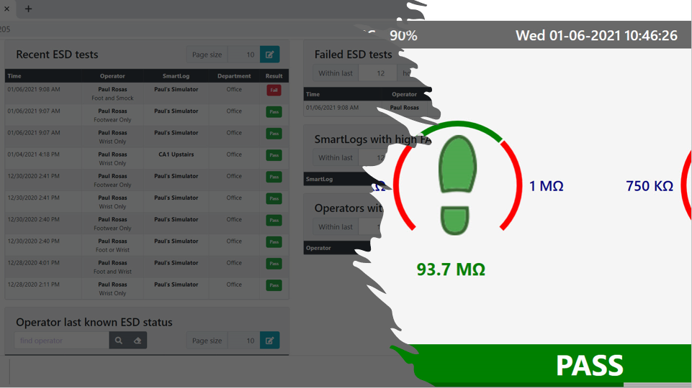
Daily Operator Testing
Transactions Logged in Server Software
Daily ESD Reports
Process Validation

Slide 4
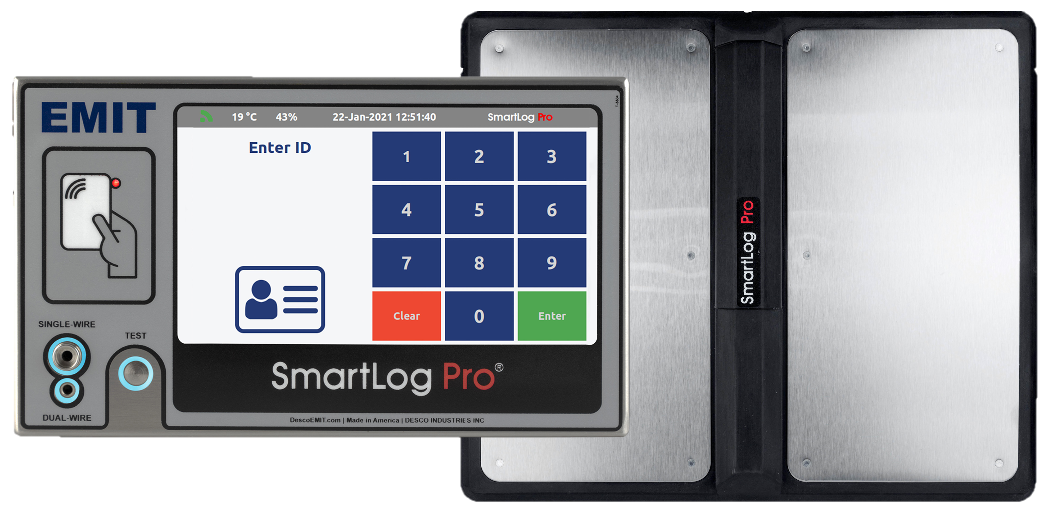
Internal Data Storage
WiFi Connectivity
Digital Numeric Keypad
7-inch Color Touch Screen Display
RFIDeas
Proximity Reader
Single-wire and Dual-wire Testing
Solid State Touch Switch
Dual Foot Plate for Independent Footwear Testing

Slide 5
Temperature and Humidity Values (°C or °F)
Time and Date
Network Status Icon
Dedicated Test Icons
(Wrist / Foot / Smock)
Measured Resistance of Each Test
(kΩ / MΩ / GΩ)
Adjustable Test Limits
Color Coded Test Results
(Green = Pass / Red = Fail)

Slide 6
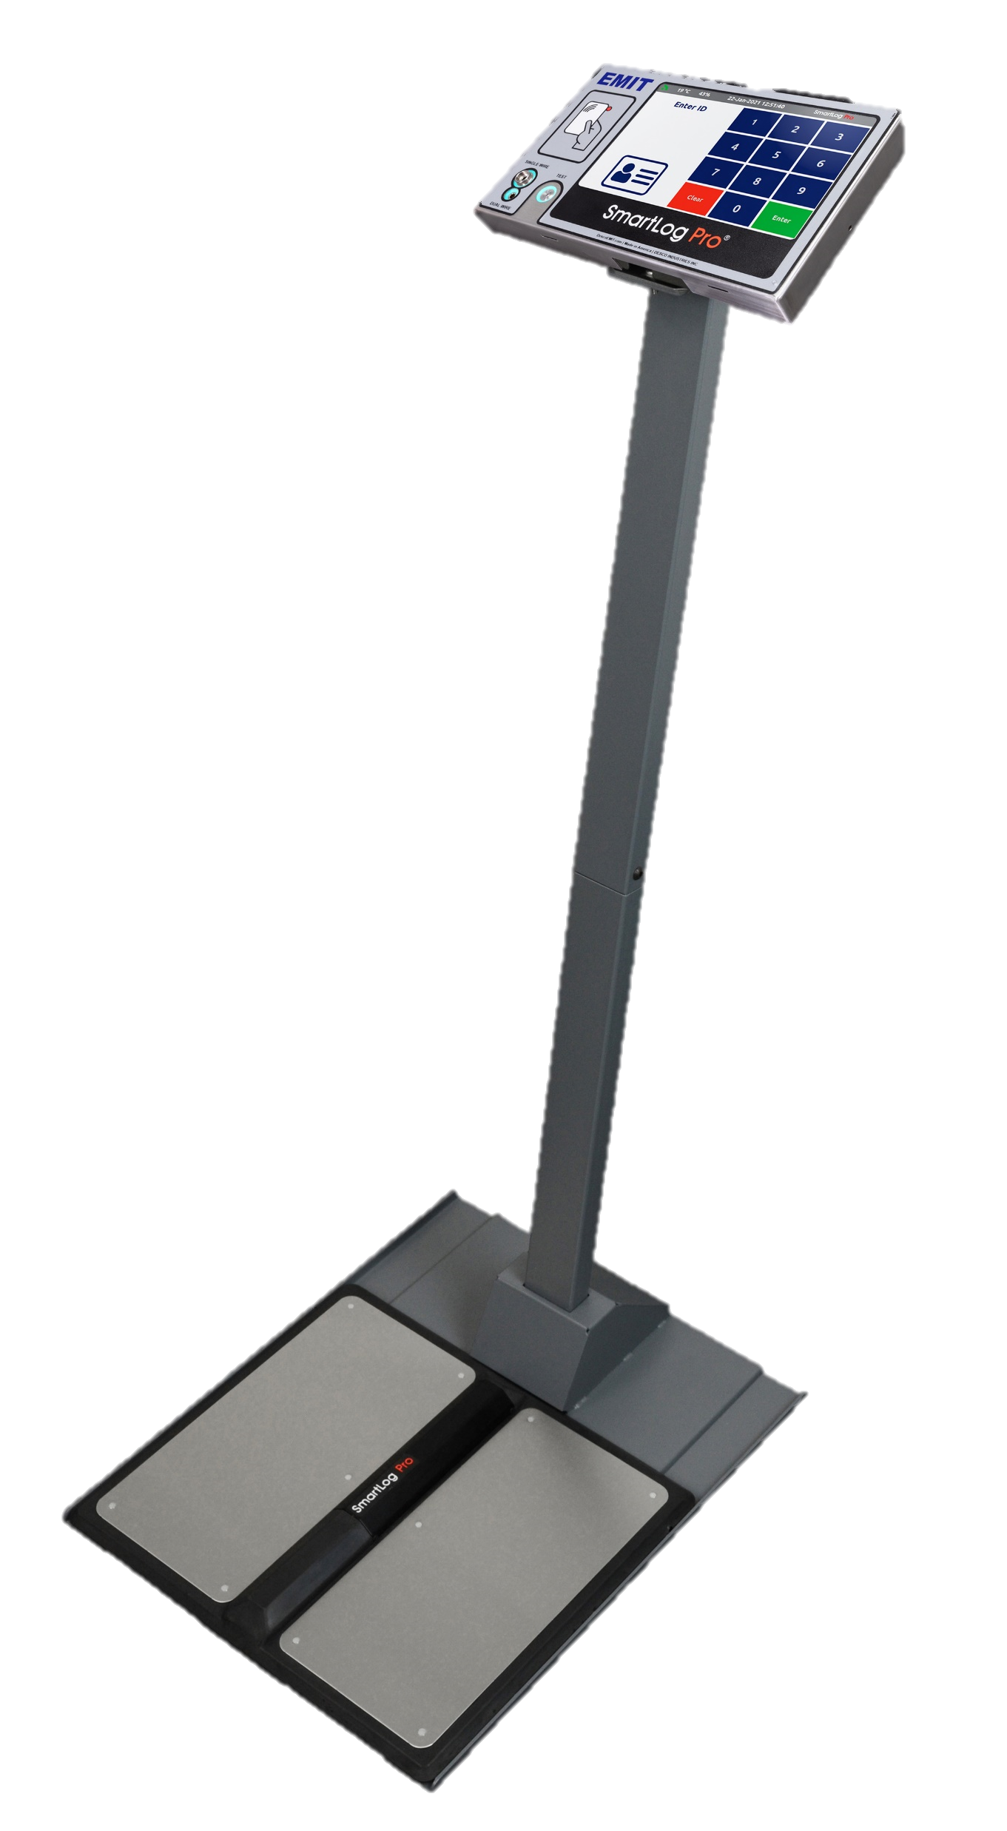
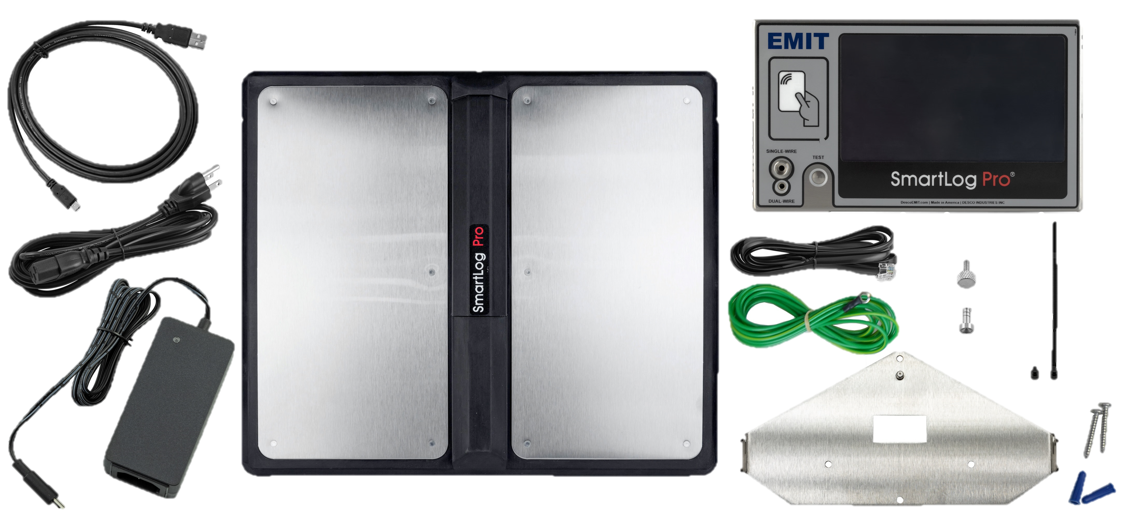
Optional Stand
Available
SmartLog Pro® 2
Mounting Bracket
Dual Independent Foot Plate
Power Adapter and Cabling

Slide 7
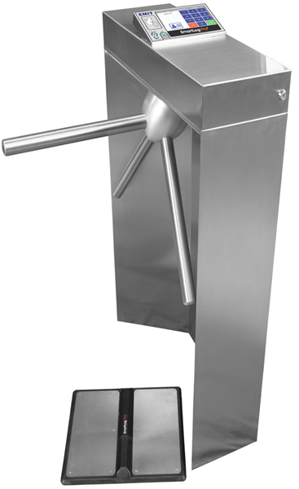
The EMIT SmartLog Pro® 2 with Alvarado EDC Waist High Turnstile controls access to the ESD Protected Area to operators that have passed their pre-defined ESD tests and have been granted access to the area.
Turnstile functionality and operator access may be managed using the SmartLog Pro® Manager Web App.
Access Features:
Control access to the ESD Protected Area
Records operator access and ESD test results
Restrict access by department, shift, or specific notation
Key Turnstile Features:
Motorized arm rotation
Field configurable for single direction or bi-directional operation
Configurable with pre-existing fire and safety systems

Slide 8
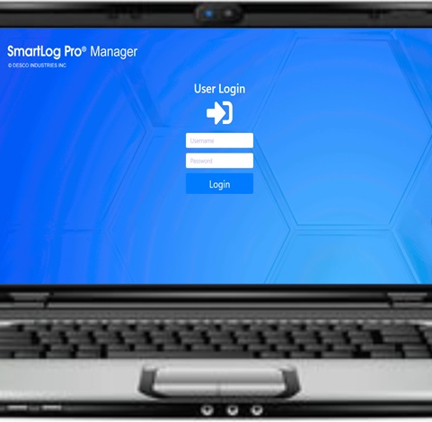
SmartLog Pro® Manager
Web App

Slide 9
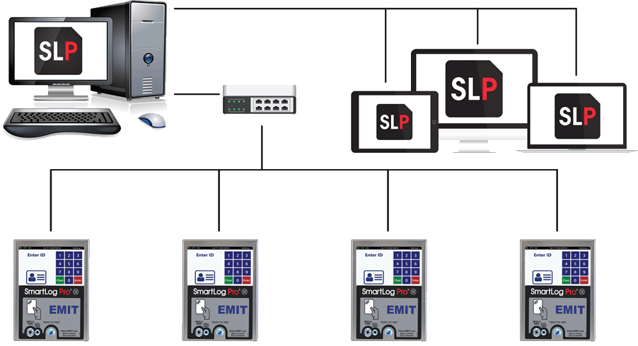
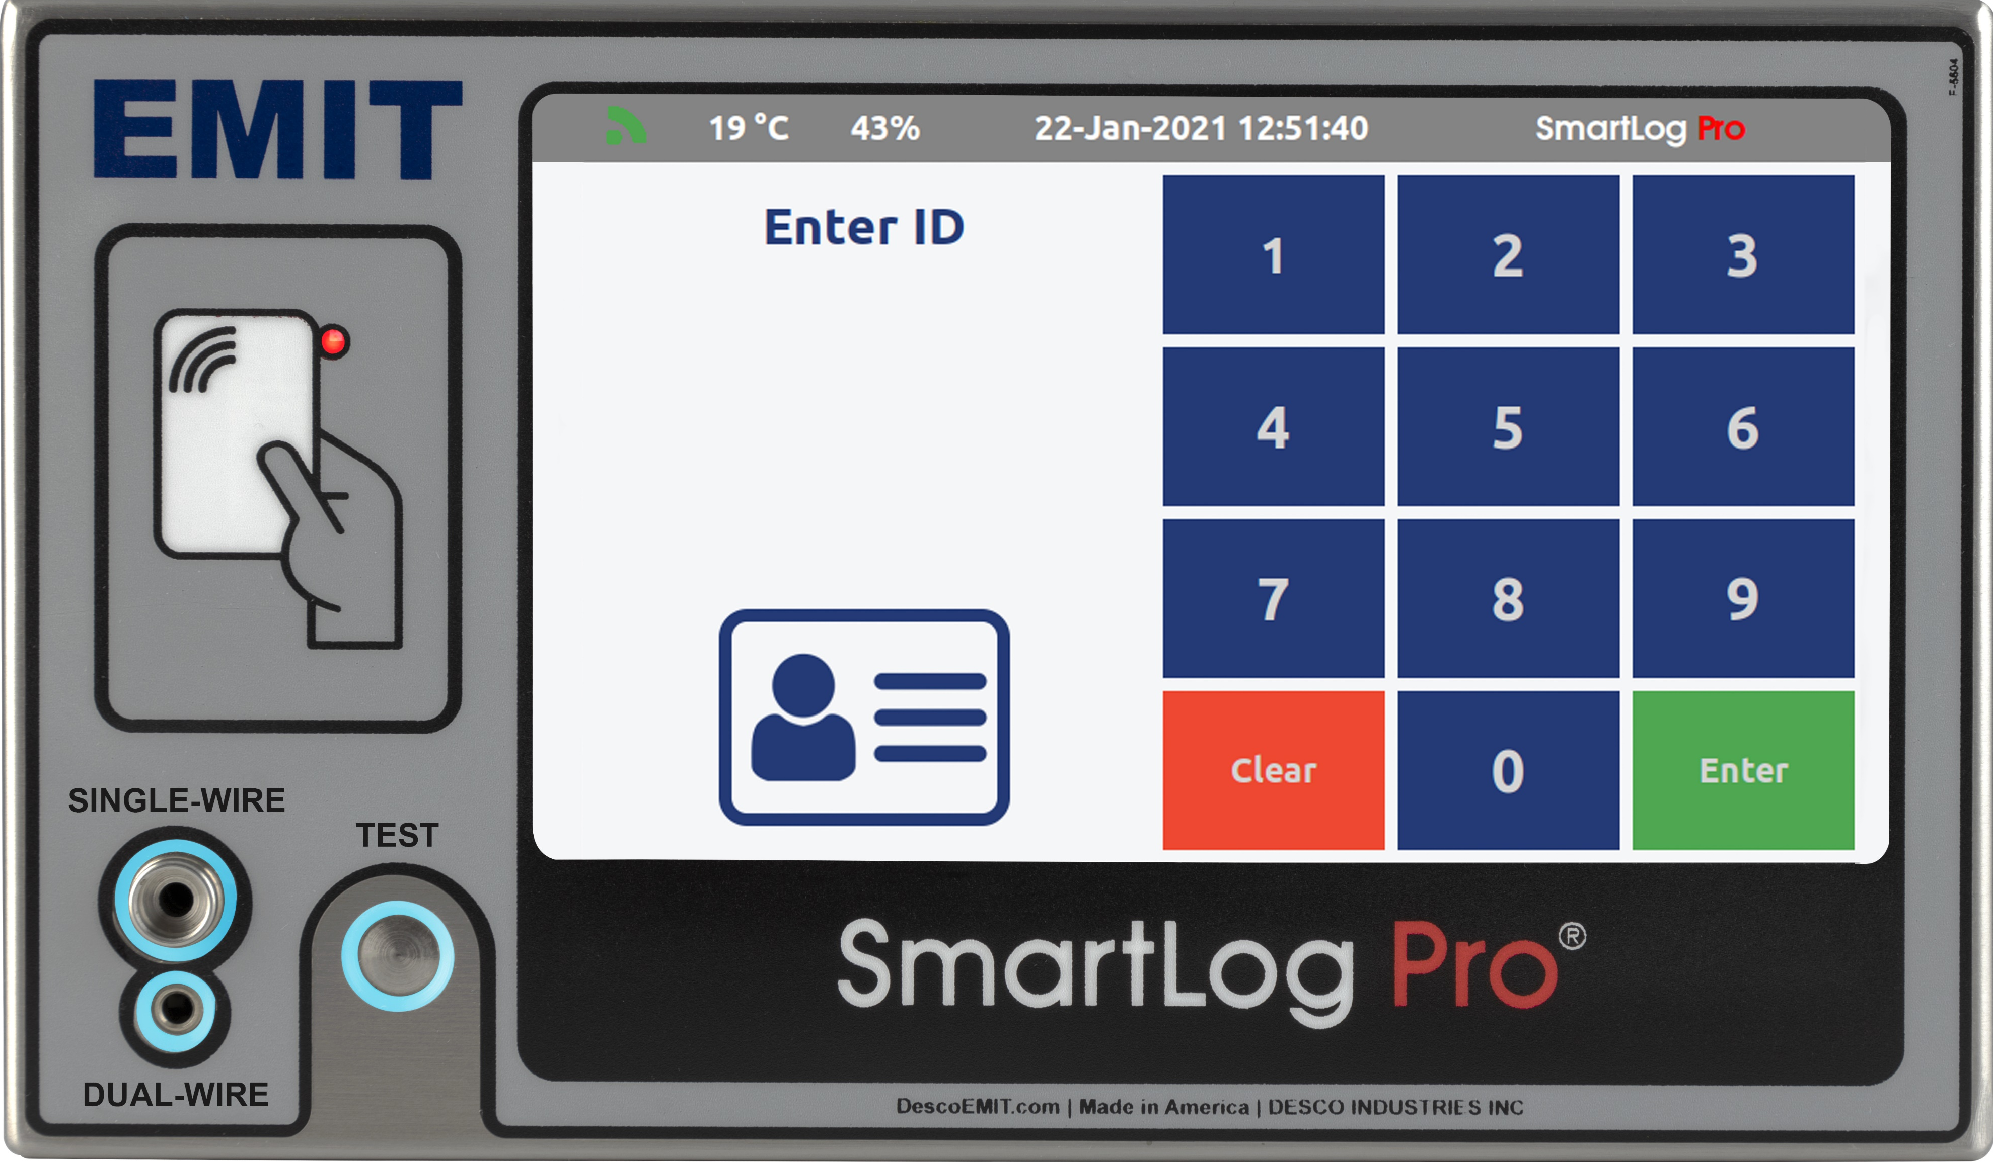
Use SmartLog Pro® Manager to meet the ANSI/ESD S20.20 requirements for an ESD Control Plan. The app is installed onto one server and accessed via a web browser. Each log entry includes operator identification, test results, resistance measurements, time, temperature, and humidity.
SmartLog Pro® Manager API
Hosted on Microsoft Windows Machine
Manager uses API services to expose full functionality to client applications.
API services are highly optimized for speed and throughput.
Manager API runs in the background requiring no manual intervention
SmartLog Pro® Manager Web App
Accessed via web browsers
Manager Web App formatted for use on a PC, Laptop and Tablet
Compatible with Google Chrome, Firefox and Microsoft Edge
Real-time test results from all SmartLog Pro SE devices on the network
SmartLog Pro® 2
SmartLog Pro® 2
SmartLog Pro® 2
SmartLog Pro® 2

Slide 10
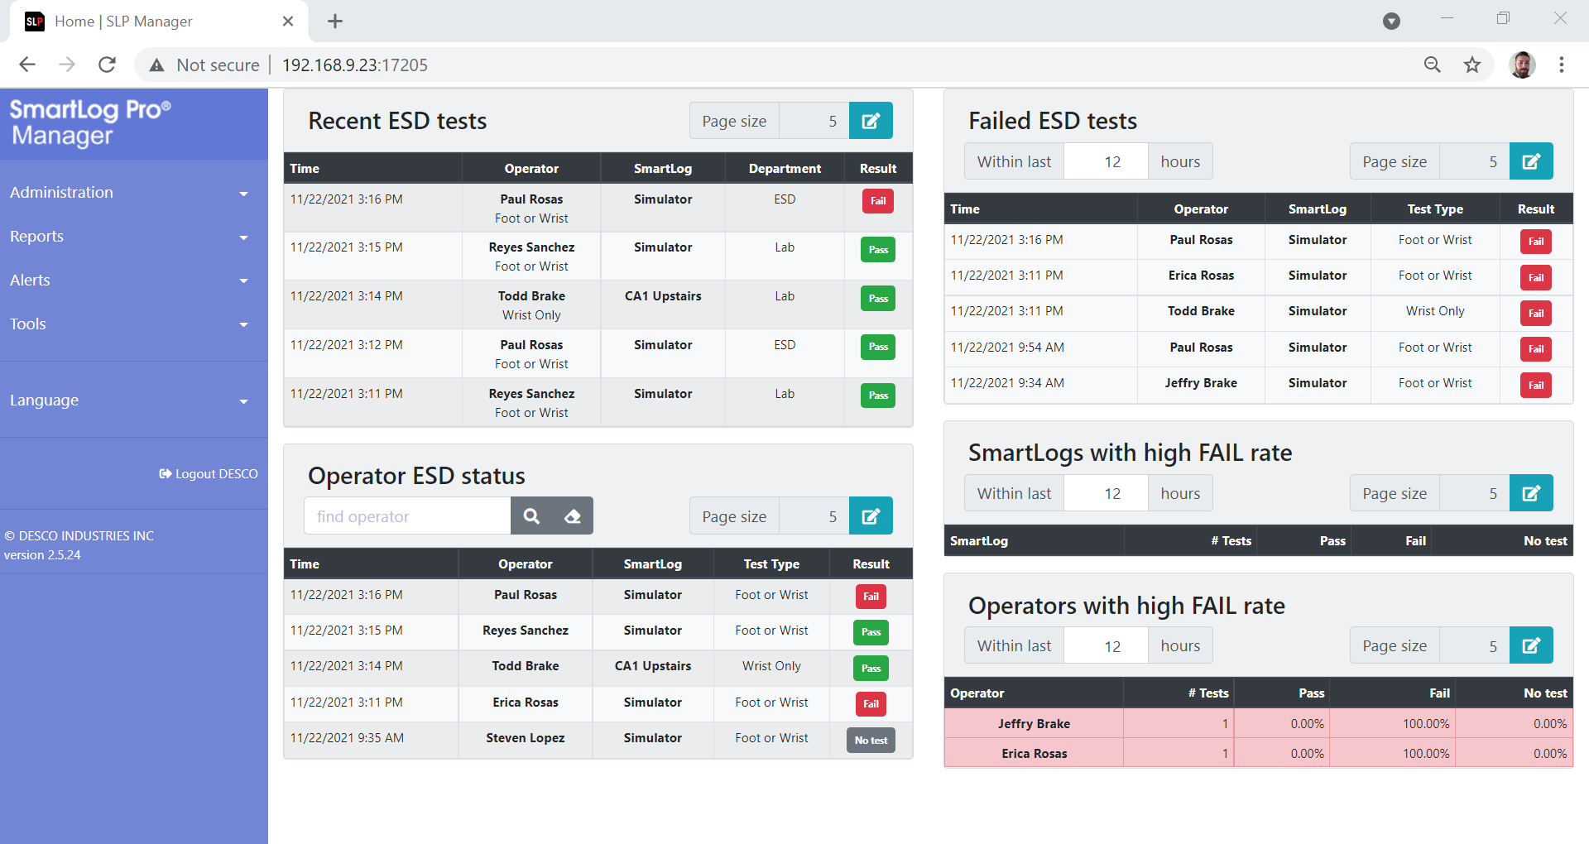
ESD Dashboard
Real-time ESD results from all SmartLog Pro® devices
Current ESD Status of each Operator
Accessible from any PC/Laptop/Tablet/Smart Phone on the network

Slide 11
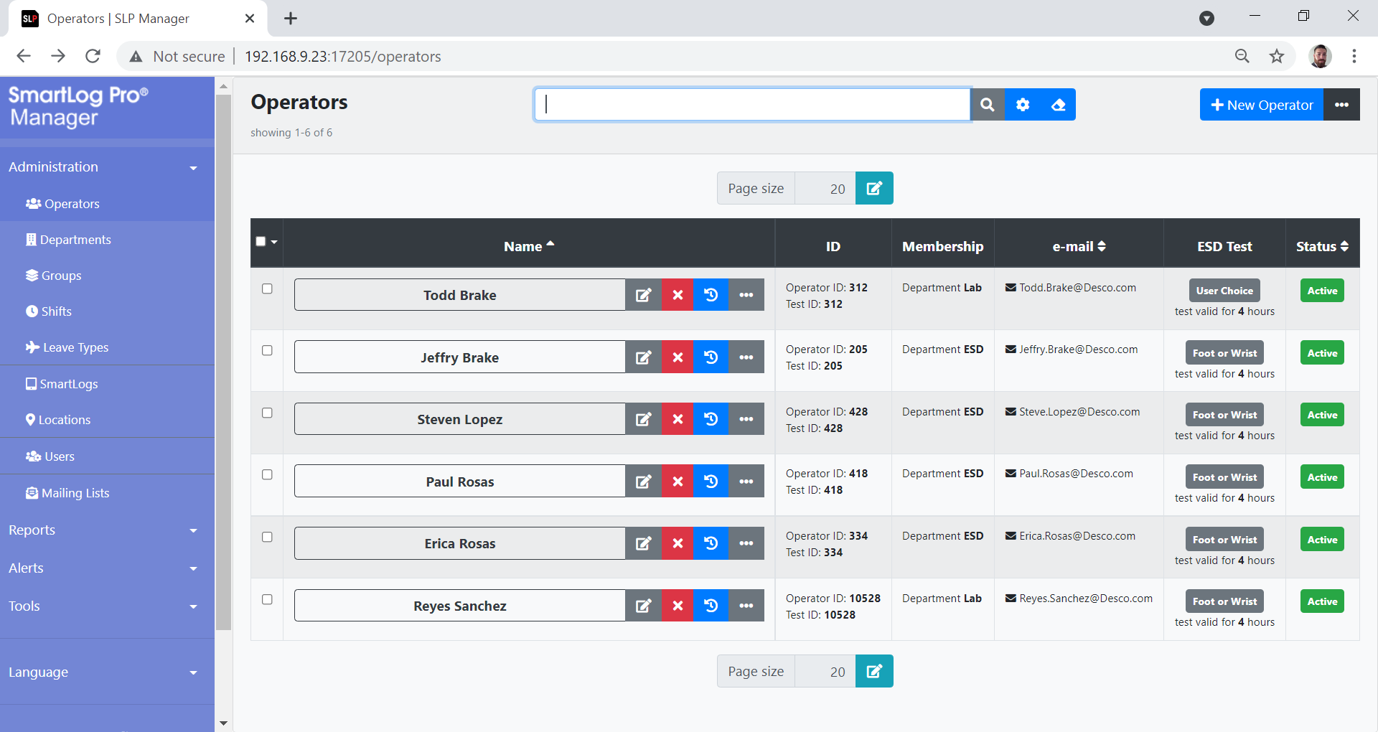
Operator Management
Manage operators daily testing requirements, shifts, leave times, etc.
Auto operator import capabilities
Visitor/Temp operator profile feature

Slide 12
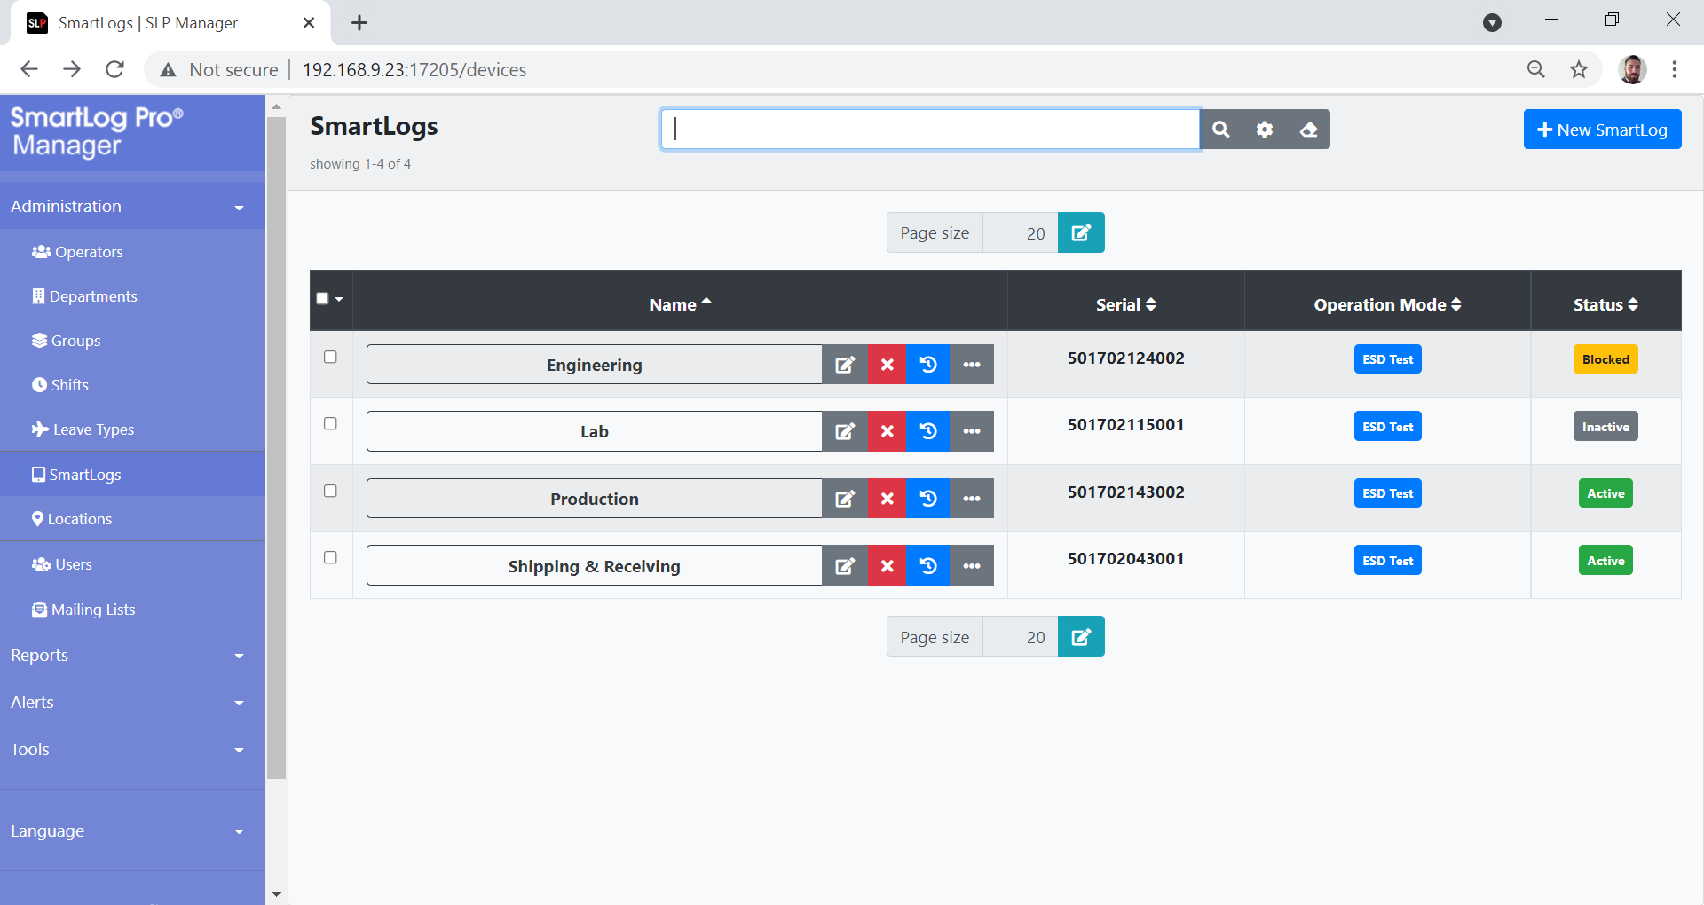
SmartLog Management
Monitor and manage activity of all SmartLog Pro® devices on the network
Color coded status indicators of all SmartLog Pro® devices
Various operation modes available including ESD Test, Time Clock and Access Control

Slide 13
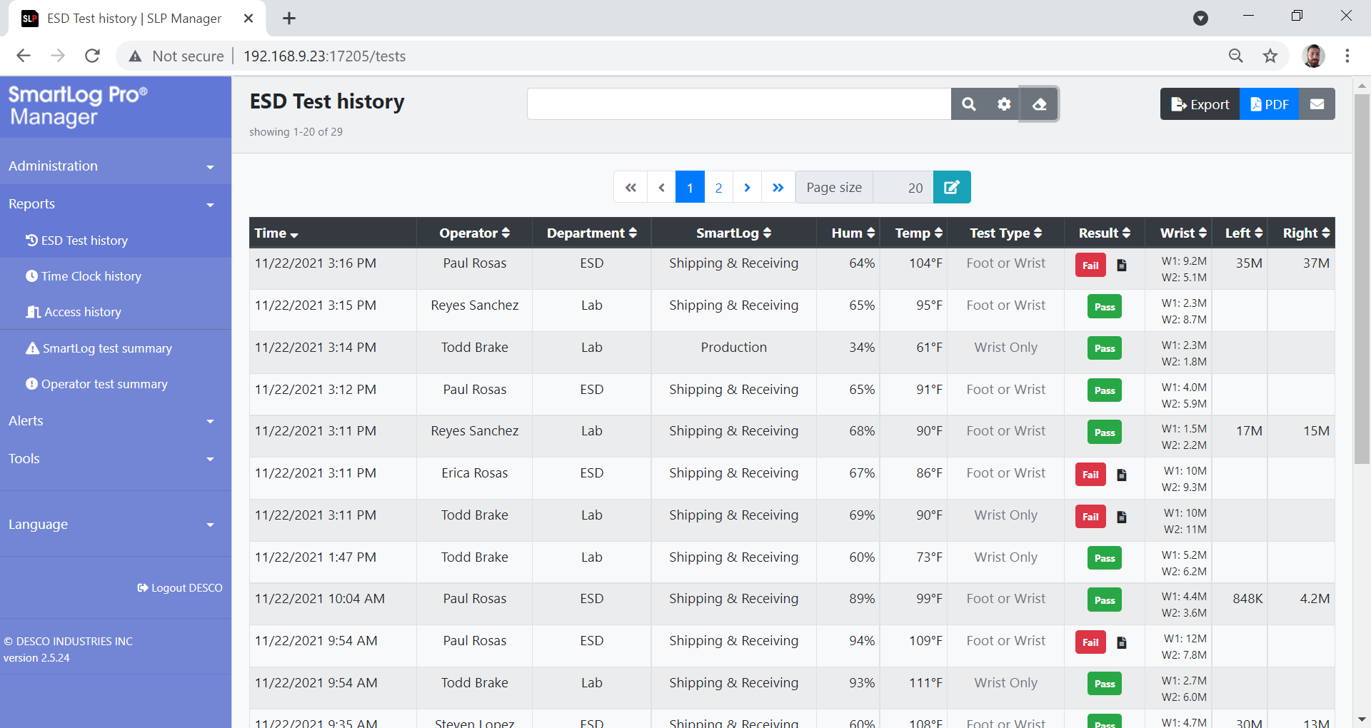
ESD Test History
Real-time results of current and past ESD transactions
Filter results by Operator, Department, Result, etc.
Fault notepad feature for documenting failed tests

Slide 14
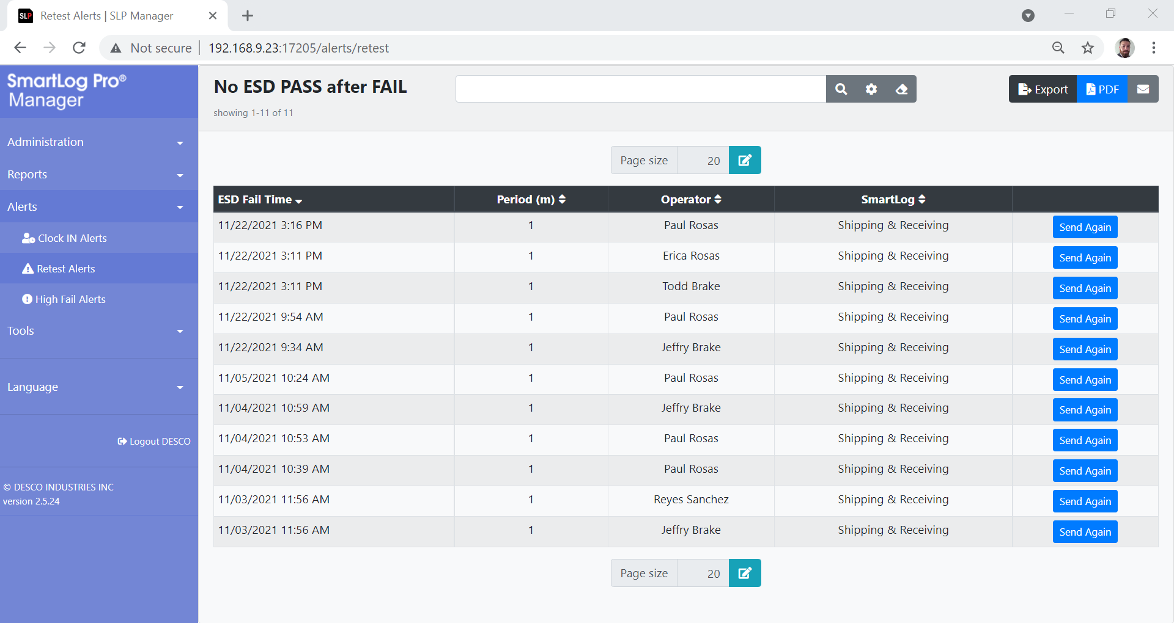
Alerts
Preset emailed alerts notifying Supervisors of immediate failures
Controllable settings for each type of emailed alert
Current and Past reports of all Alerts sent

Slide 15
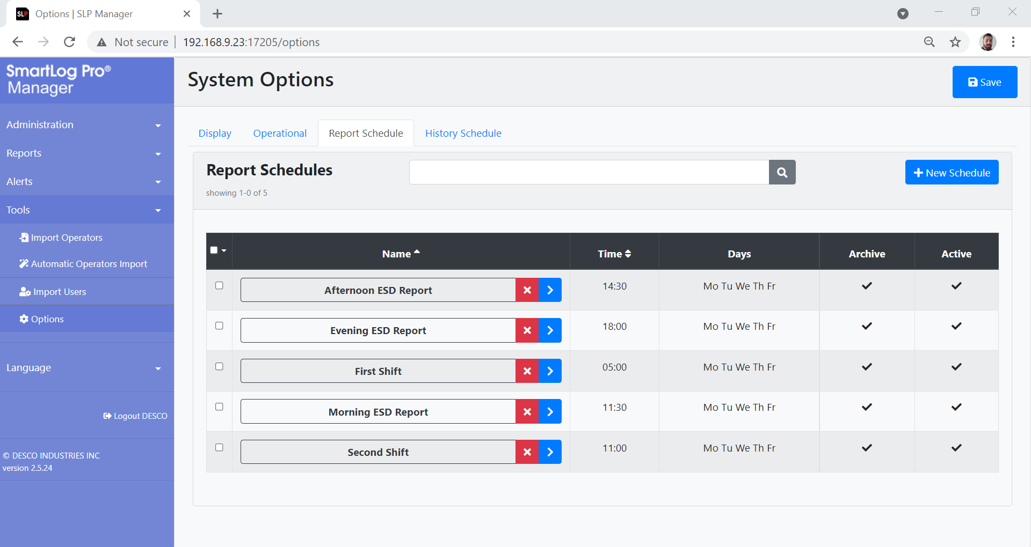
Emailed Reports
Schedule multiple ESD reports throughout the day/week
Filterable data by Operator, Result, Department, etc.
Archive feature allows copies of the reports to be saved for remote access

Slide 16
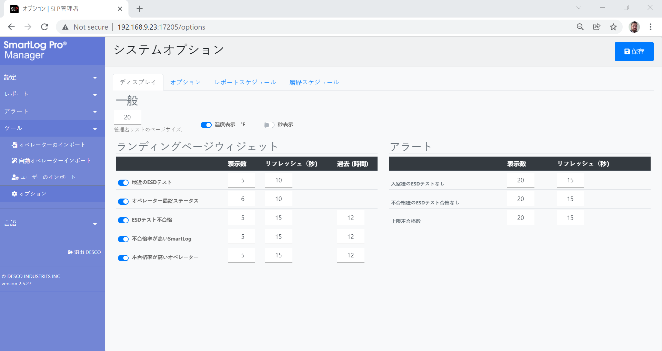
Languages
All language in Web Manager Software is translatable
Preset language options include Spanish, Japanese, French and more
Language on the SmartLog Pro® devices can also be translated

Slide 17
Need More Information or a Demo?
For a virtual or in-house demonstrations or more information, please contact the EMIT factory for your local sales representative.
EMIT
3651 Walnut Ave
Chino, CA 91710
Phone: (909)664-9980
Fax: (909)627-7449
Website: https://emit.descoindustries.com/

